Slide 1


A CAPSTONE PROJECT REPORT ON
UNIVERSITY GRADING SYSTEM FOR CGPA CALCULATION
Submitted in the partial fulfilment for the award of the degree of
BACHELOR OF ENGINEERING
IN
COMPUTER SCIENCE
Submitted by
R. Santhosh Kumar (192211053)
S. Vicky Melwin (192211058)
Under the Supervision of
Jayanthi S
SIMATS SCHOOL OF ENGINEERING
THANDALAM CHENNAI-602105

Slide 2
Description:
The University Grading System for CGPA Calculation is designed to automate the process of calculating Cumulative Grade Point Averages (CGPA) for students based on their academic performance. This system incorporates object-oriented programming principles to create a flexible and efficient platform that can adapt to evolving grading criteria and policies. The system includes features such as grade entry, CGPA calculation, course management, and result analysis to provide a comprehensive tool for academic record management.
Key Components:
Student Class: Represents individual students with attributes such as student ID, name, and academic history.
Manages course enrollments, grades, and CGPA calculations for each student. Implements validation checks for course entries and grade inputs.
Course Class: Represents academic courses with details like course code, title, and credit hours.
Manages grading criteria, including letter grades and corresponding grade points. Provides methods for adding, updating, or removing courses.
Grade Class: Defines letter grades and their corresponding grade points.
Incorporates standard grading scales and allows customization based on university policies.
Ensures consistency and accuracy in grade-point assignments.
CGPA Calculator Class:Performs CGPA calculations based on the grades and credit hours of enrolled courses.
Handles weighted averaging for courses with different credit hours. Adheres to university-specific CGPA calculation formulas.

Slide 3
Introduction and Project Overview:
In the academic domain, accurate and automated CGPA calculation is crucial for transparent evaluation and record management. This University Grading System aims to streamline the process, utilizing object-oriented programming to create a user-friendly and adaptable platform. Through encapsulation, inheritance, polymorphism, and abstraction, the system ensures efficient data organization and ease of maintenance. Additionally, the user-friendly interface empowers users to navigate academic data effectively. Students can access their grades and monitor their progress easily, while instructors and administrators gain valuable insights into student performance trends.The system's adaptability allows for seamless integration of new features and customization of grading criteria to meet evolving educational needs.
Scalability ensures it can grow alongside the institution, supporting its long- term goals.Furthermore, robust security measures protect sensitive student information, ensuring compliance with regulatory requirements and maintaining data confidentiality.In summary, the University Grading System for CGPA Calculation represents an efficient and adaptable solution for transparent evaluation and record management in academia.
Objectives and Goals:
Automation of Grading:
Implement automated grading for each course based on predefined criteria. Allow flexibility for instructors to adjust grading components.
One of the primary objectives of the system is to automate the calculation of Cumulative Grade Point Averages (CGPA) for students. This automation significantly reduces the administrative burden on educational institutions and ensures accuracy and consistency in GPA calculations across different courses and semesters.

Slide 4
Accurate CGPA Calculation:
Develop a precise CGPA calculation mechanism considering course credit hours.
Incorporate real-time updates for grades and course enrollments. User-Friendly Interface:
Design an intuitive user interface for students, instructors, and administrators.
Ensure a seamless experience for entering grades and managing courses.
PROJECT SCOPE:
The project scope encompasses the development of a comprehensive University Grading System for CGPA Calculation. This system aims to automate the process of calculating Cumulative Grade Point Averages (CGPA) for students based on their academic performance and to deliver a fully functional, user-friendly, and secure University Grading System that automates CGPA calculation and facilitates transparent evaluation and record management in academia.
Technologies and Tools:
C++ Programming Language: C++ will be the primary language for developing the core logic of the grading system. It provides high performance, flexibility, and extensive support for object-oriented programming, making it suitable for system development.
Integrated Development Environment (IDE): An IDE such as Visual Studio, Code::Blocks, or CLion will be employed for writing, debugging, and testing the C++ code. These IDEs offer features like syntax highlighting, code completion, and debugging tools that enhance the development process.
Console Input/Output: Standard input/output functions provided by C++ (e.g., cout, cin) will be used to interact with users via the console. This allows for simple and straightforward communication with the grading system, facilitating user input for grade entry, course management, and other functionalities.

Slide 5
Random Number Generation: The C++ standard library's random number generation utilities (e.g., rand, srand) may be utilized for generating random choices or data within the grading system. While not a core component, random number generation may be useful for certain aspects of the system, such as generating test data or simulating scenarios.
Project Deliverables:
Functional CGPA Calculation System:
The primary deliverable of the project is a fully functional University Grading System capable of handling tasks such as entering grades, managing courses, and accurately calculating CGPA for students. This system will automate the process of evaluating academic performance and computing cumulative grade point averages, streamlining administrative tasks and providing transparent evaluation mechanisms.
Source Code:
The project will provide comprehensive, well-documented, and commented source code written in C++ following best practices and coding standards. The source code will be structured, modular, and easily understandable, facilitating future maintenance, enhancements, and collaboration among developers.
User Interface (UI):
An intuitive and user-friendly graphical user interface (GUI) will be developed to ensure seamless interaction with the grading system. The UI will feature easy-to-navigate menus, input forms, and visual feedback mechanisms, enhancing user experience and accessibility for students, instructors, and administrators.
Project Overview:
A detailed introductory document will be presented, outlining the project's objectives, scope, and key features. This overview will provide stakeholders with a comprehensive understanding of the project's purpose, functionality, and expected outcomes. It will serve as a roadmap for project planning, execution, and evaluation.

Slide 6
System Architecture:
Comprehensive system architecture documentation will be provided, including detailed class diagrams and interaction diagrams. These diagrams will illustrate the structure, relationships, and interactions among different components of the grading system, enabling stakeholders to visualize the system's design and functionality. The architecture documentation will serve as a blueprint for system implementation, testing, and maintenance, ensuring consistency and scalability across the project lifecycle.
TASK | DAY 1-2 | DAY 3-4 | DAY 5-6 | DAY 7
PLANNING AND DESIGN
CLASS IMPLEMENTATION
USER INTERFACE AND GRADING AUTOMATION
TESTING AND DOCUMENTATION
Timeline and Milestones:
Day 1-2: Planning and Design:
Define project scope, objectives, and key features.
Identify grading components and course management requirements.
Day 3-4: Class Implementation:
Implement classes for Student, Course, Grade, and CGPA Calculator. Ensure proper encapsulation and data integrity.
Day 5-6: User Interface and Grading Automation:
Develop user input methods for grades and course management. Implement automated grading components.
Day 7: Testing and Documentation:
Conduct thorough testing of CGPA calculations. Document code, class diagrams, and user instructions.

Slide 7
Milestones:
Milestone 1 (End of Day 2):
Completion of detailed project scope and class design documentation.
Milestone 2 (End of Day 4):
Implementation of Student, Course, and Grade classes with preliminary testing.
Milestone 3 (End of Day 6):
Integration of CGPA Calculator, automation of grading, and initial user interface development.
Milestone 4 (End of Day 7):
Completion of testing, documentation, and finalization of the grading system.
Potential Challenges and Solutions:
Dynamic Grading Policies:
Challenge: Adapting to changing grading policies and criteria.
Solution: Design the system to allow flexible configuration of grading components.
User Input Validation:
Challenge: Ensuring valid input for grades and course management.
Solution: Implement thorough input validation mechanisms and error handling.
Scalability:
Challenge: Handling a large number of students and courses.
Solution: Optimize data structures and consider implementing a database for scalability
OBJECT ORIENTATED DESIGN:
For the University Grading System for CGPA Calculation project, the effective use of object-oriented design principles is essential for creating a robust and maintainable system. Here's how each principle can be utilized effectively:

Slide 8
Classes:
Utilize classes to represent key entities in the system, such as Student, Course, Grade, and CGPA Calculator.Each class should encapsulate related data and behavior, providing a clear and modular structure to the system.
Encapsulation:
Encapsulate the internal state of each class by making data members private and providing public methods to access and manipulate them.
Encapsulation ensures data integrity and hides the implementation details, allowing for easier maintenance and modification of the system.
Inheritance:
Use inheritance to model the relationships between classes, where one class (subclass or derived class) inherits attributes and behaviors from another class (superclass or base class).For example, you could have subclasses like UndergraduateStudent and GraduateStudent inheriting from a superclass Student, each with specialized behaviors and attributes.
Polymorphism:
Leverage polymorphism to allow objects of different classes to be treated uniformly through a common interface.Implement polymorphism through method overriding (runtime polymorphism) and method overloading (compile- time polymorphism) to provide flexibility and extensibility in the system.For instance, you could have a common displayGrade() method in the Grade class that behaves differently based on the type of grade (letter grade or numerical grade).
CODE :
#include <iostream> #include <stdlib.h>
using namespace std;
void calculateGPA(); void calculateCGPA();
void method(); int main()

Slide 9
{
system("cls"); int input;
cout<<" "<<endl;
cout<<" GPA & CGPA Calculator (Developed by Ohid) "<<endl;
cout<<"
\n"<<endl;
cout<<" cout<<" cout<<"
MENU:"<<endl;
Calculate GPA (Grade Point Average)"<<endl;
Calculate CGPA (Cummulative Grade Point
Average)"<<endl; cout<<"
CGPA"<<endl;
cout<<"
3. Method that is applied here for calclating GPA &
4. Exit Application"<<endl;
cout<<" "<<endl;
sub:
cout<<"Enter your choice: "; cin>>input;
switch(input)
{
case 1:
calculateGPA(); break;
case 2:
calculateCGPA(); break;

Slide 10
case 3:
method(); break;
case 4:
exit(EXIT_SUCCESS);
break; default:
cout<<"You have entered wrong input.Try again!\n"<<endl;
goto sub; break;
}}
void calculateGPA()
{
int q; system("cls");
cout<<"-------------- GPA Calculating -----------------"<<endl; cout<<" How many subject's points do you want to calculate? : "; cin>>q;
float credit [q]; float point [q];
cout<<endl;
for(int i=0;i<q;i++)
{
cout<<"Enter the credit for the subject "<<i+1<<": "; cin>>credit[i];
cout<<endl;
cout<<"Enter the point of the subject "<<i+1<<": ";

Slide 11
cin>>point[i];
cout<<" \n\n"<<endl;
}
float sum=0; float tot;
for(int j=0;j<q;j++)
{
tot=credit[j]*point[j]; sum=sum+tot;
}float totCr=0;
for(int k=0;k<q;k++)
{
totCr=totCr+credit[k];
}
cout<<"\n\n\nTotal Points: "<<sum<<" . Total Credits: "<<totCr<<" .Total GPA: "<<sum/totCr<<" ."<<endl;
sub:
int inmenu;
cout<<"\n\n\n1. Calculate Again"<<endl;
cout<<"2. Go Back to Main Menu"<<endl; cout<<"3. Exit This App \n\n"<<endl; cout<<"Your Input: "<<endl; cin>>inmenu;
switch(inmenu)
{
case 1:
calculateGPA(); break;

Slide 12
case 2:
main(); break;
case 3:
exit(EXIT_SUCCESS);
default:
cout<<"\n\nYou have Entered Wrong Input!Please Choose Again!"<<endl;
goto sub;
}
}
void calculateCGPA()
{
system("cls"); int l;
cout<<"-------------- CGPA Calculating -----------------\n\n"<<endl; cout<<"How many semester results do you want input? :";
cin>>l; cout<<"\n\n"<<endl;
float semrs[l]; int i;
for(i=0;i<l;i++)
{
cout<<" Enter Semester "<<i+1<<" Result(GPA): "; cin>>semrs[i];
cout<<"\n"<<endl;
} float semtot=0; for(int j=0;j<l;j++)

Slide 13
{
semtot=semtot+semrs[j];
}
cout<<"******** Your CGPA is "<<semtot/l<<" **********"<<endl; sub:
int inmenu;
cout<<"\n\n\n1. Calculate Again"<<endl; cout<<"2. Go Back to Main Menu"<<endl; cout<<"3. Exit This App \n\n"<<endl; cout<<"Your Input: "<<endl; cin>>inmenu;
switch(inmenu)
{
case 1:
calculateCGPA(); break;
case 2:
main(); break;
case 3:
exit(EXIT_SUCCESS);
default:
cout<<"\n\nYou have Entered Wrong Input!Please Choose Again!"<<endl;
goto sub;
}}
void method()
{

Slide 14
system("cls");
cout<<"--------------- Method of Calculating GPA & CGPA ---------------
\n\n"<<endl;
cout<<" GPA= Sum of (Credit*Point) / total of credits \n"<<endl; cout<<" CGPA= Sum of GPA / number of semesters "<<endl;
cout<<" \n\n"<<endl; sub:
int inmenu;
cout<<"1. Go Back to Main Menu"<<endl; cout<<"2. Exit This App \n\n"<<endl; cout<<"Your Input: "<<endl; cin>>inmenu;
switch(inmenu)
{
case 1:
main(); break;
case 2:
exit(EXIT_SUCCESS);
default:
cout<<"\n\nYou have Entered Wrong Input!Please Choose Again!"<<endl;
goto sub;
}
};

Slide 15
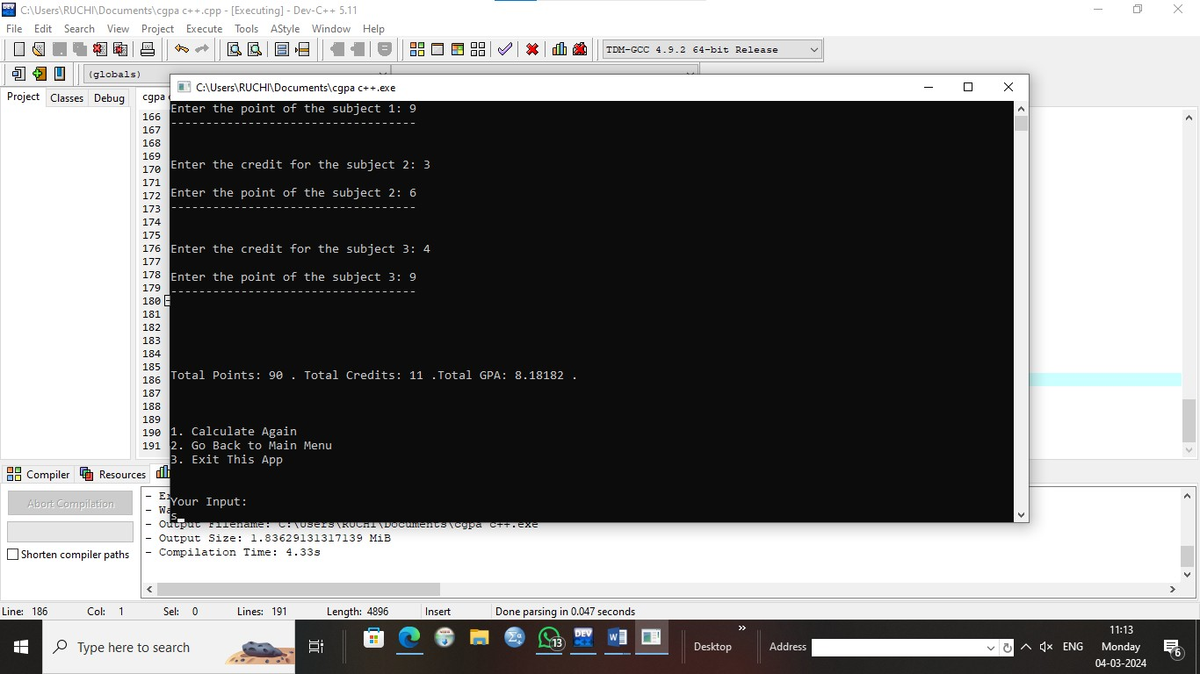
OUTPUT:
CODE QUALITY:
Readability:
Maintain consistent naming conventions for variables, classes, and methods. Keep functions and methods concise and focused.
Use meaningful comments and whitespace to enhance readability.
Modularity:
Organize code into modules or classes representing distinct functionalities.
Ensure each module has a well-defined responsibility and minimal dependencies.
Implement encapsulation to hide internal details and reduce coupling.
Comments/Documentation:
Provide inline comments for complex algorithms or non-obvious logic. Include descriptive docstrings for classes, methods, and functions

Slide 16
Conclusion:
In conclusion, the University Grading System for CGPA Calculation leverages object-oriented programming principles to create an efficient and adaptable platform. By automating grading processes and ensuring accurate CGPA calculations, the system aims to enhance the overall academic record management experience. The user-friendly interface and adherence to best practices contribute to a reliable and scalable solution for universities and educational institutions.

